Slide 1
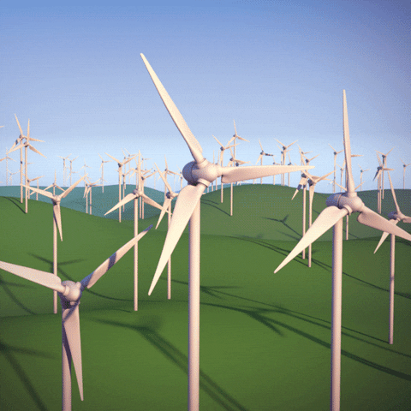
Fault Detection and Power Prediction of Wind Turbines
Proposal
Mahy Ayman, Zeina Tamer,
Nour Mahmoud, Mariam Othman
Supervised by: Dr Youmna Mahmoud,
Eng Randa Osama

Slide 2
Agenda
Introduction
Motivation
Problem Statement
Similar Systems
System Overview
Deliverables
Time Plan
Supportive Documents
Demo

Slide 3
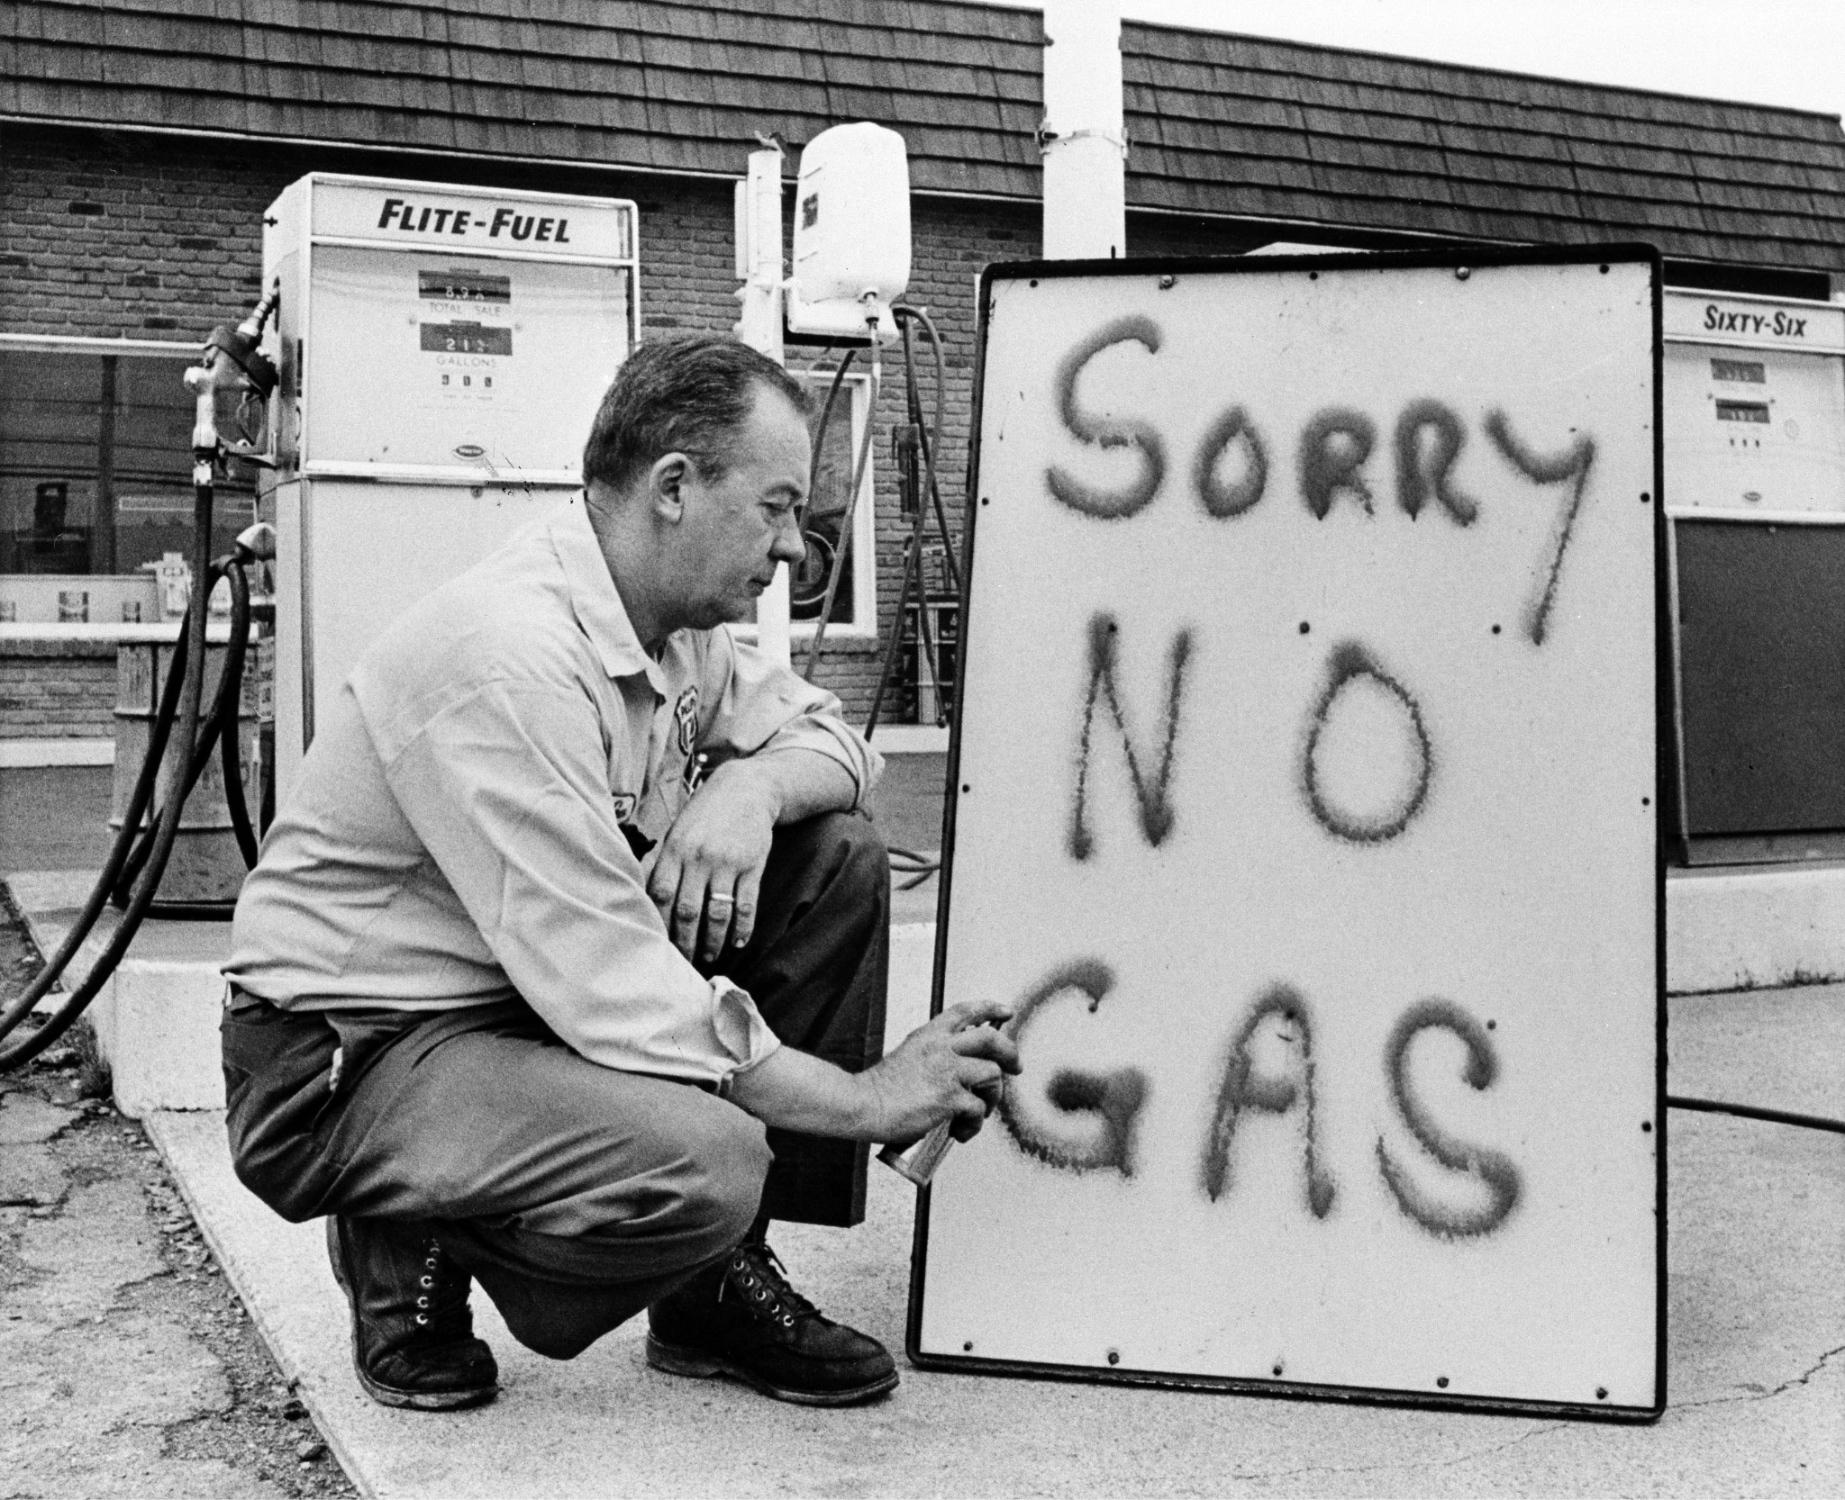
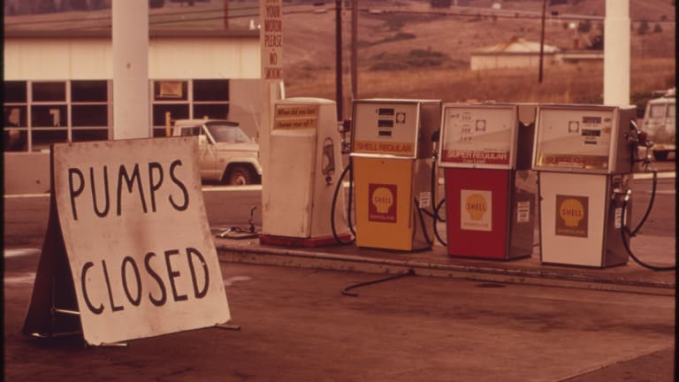
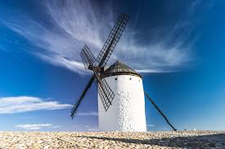
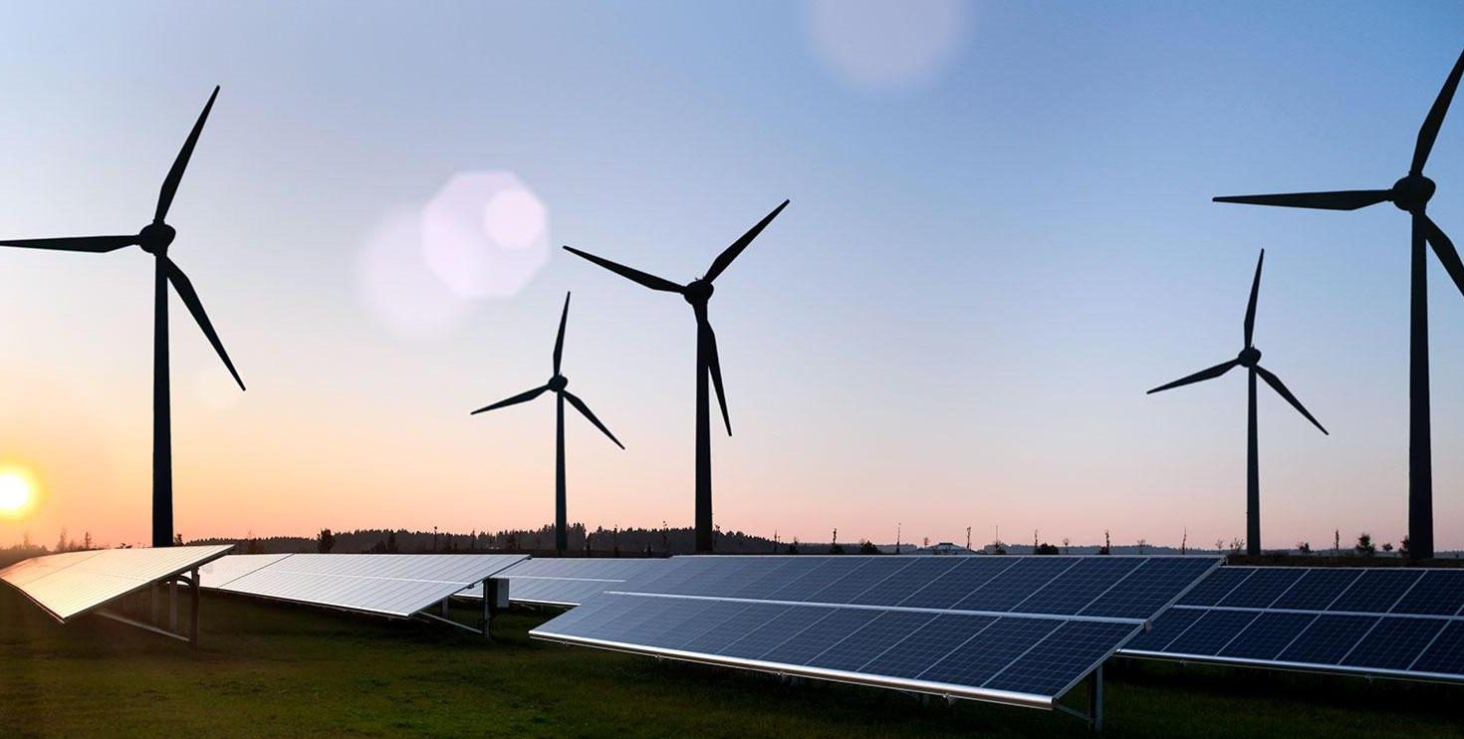
1970s Oil Crisis
Notes:
Energy is now a crucial part of living on Earth. Almost everything depends on the use of energy. For a long time, the main source of energy has been fossil fuels, which, however, comes with major drawbacks. The use of fossil fuels plays a major role in climate change and affects air pollution negatively, consequently, impacting humans and living creatures [10]. People tended to move to less harmful energy sources, and the wind was one of those.
The first sale of commercial wind turbines was finalized in 1927, to a group of US farmers for what was considered a fairly high price, but it was the 1970s oil crisis in the Middle East that pushed various governments to fund research into renewable energy as a means not only for energy security but also to battle air
pollution and climate change[17].
Maintenance of wind turbines used to occur twice a year within 6 months of each other. A thorough inspection would occur upon the system, along with repairs and replacements according to the technician. This process was deemed time-consuming and costly and that led to the introduction of condition monitoring and later machine learning for fault detection.

Slide 4



Motivation (Academic)
Notes:
A major energy source is wind. While wind can be a solution to the major climate change resulting from the use of non-renewable energy, converting it to energy is a long process that includes major steps. Since wind turbines are the source of wind energy, they require maintenance as they are placed in remote loca- tions, which subject them to failures, with harsh environmental conditions. Failures in wind turbines can be costly. A current solution that is now being implemented is to detect possible faults using condition monitoring. It, however, needs knowledgeable professionals to analyze the data and perform the work. A possible improvement to condition monitoring is using machine learning models to develop a system that would eliminate the hassle of finding professionals for doing the job.
Machine learning provided a novel solution for this need, and as a result, renewable energy sources will become more reliable and affordable and increase in expansion and potential[18].

Slide 5
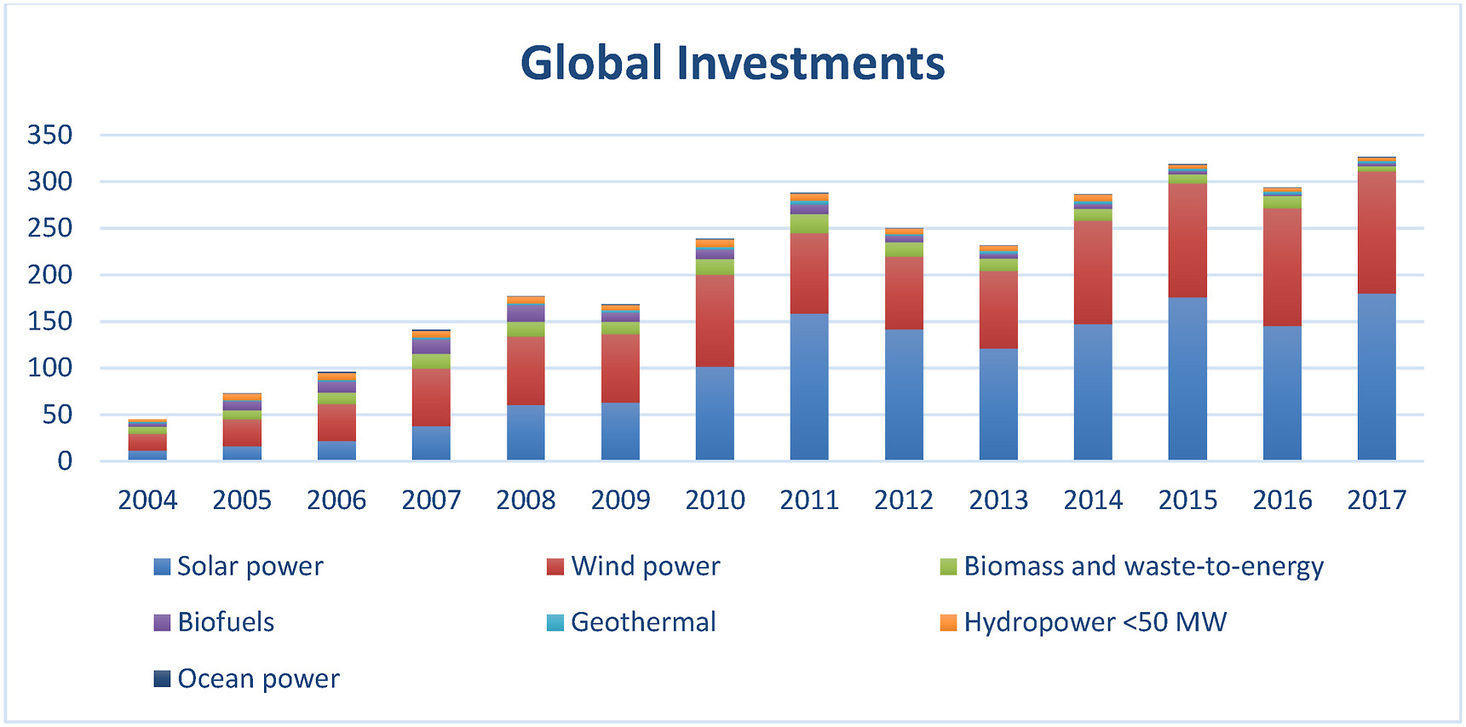
Motivation (Business)
Renewable energy sources in 2013 accounted for an estimate of 19.1% of energy consumption in the world.
The Energy Roadmap aims that the energy supply specifically of wind to reach a number between 31.6% and 48.7% in 2050 of Europe’s electricity.
$ billions
Notes:
Renewable energy sources in 2013 accounted for an estimate of 19.1% of energy consumption. The Energy Roadmap aims that the energy supply specifically of wind to reach a number between 31.6% and 48.7% in 2050 of Europe’s electricitu. This increase, however, will have a major impact on the O&M of the costs of wind turbines.[2] The figure below shows the increase in the global investments in wind power[3]. That being said, systems that could monitor and detect potential failures in wind turbines would benefit the world greatly by limiting the time of downtimes and thus minimizing loss of revenue[16].

Slide 6

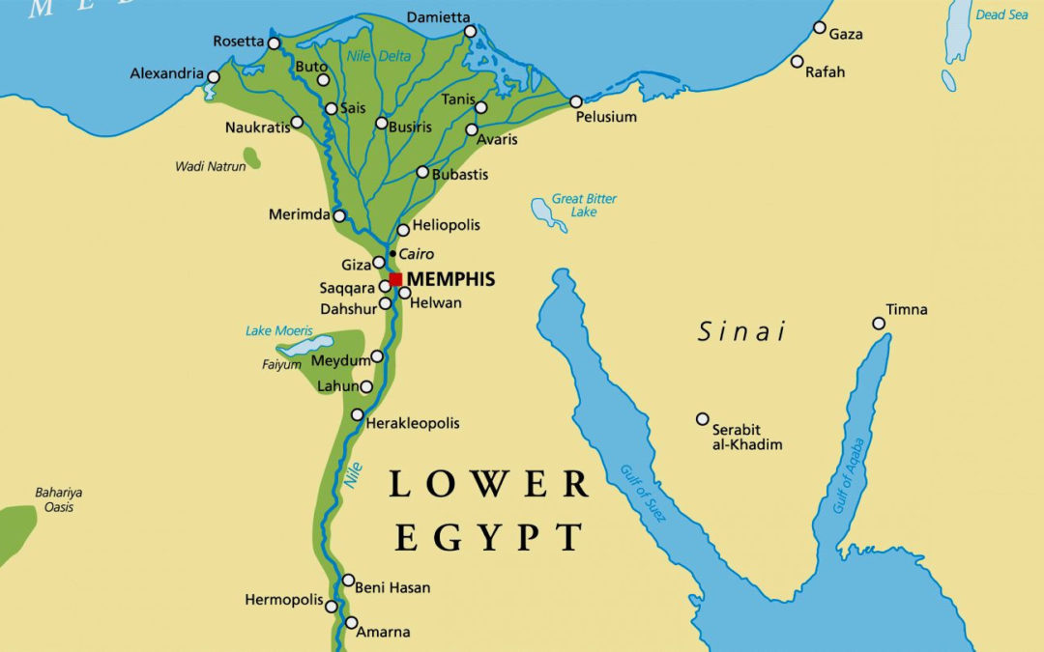

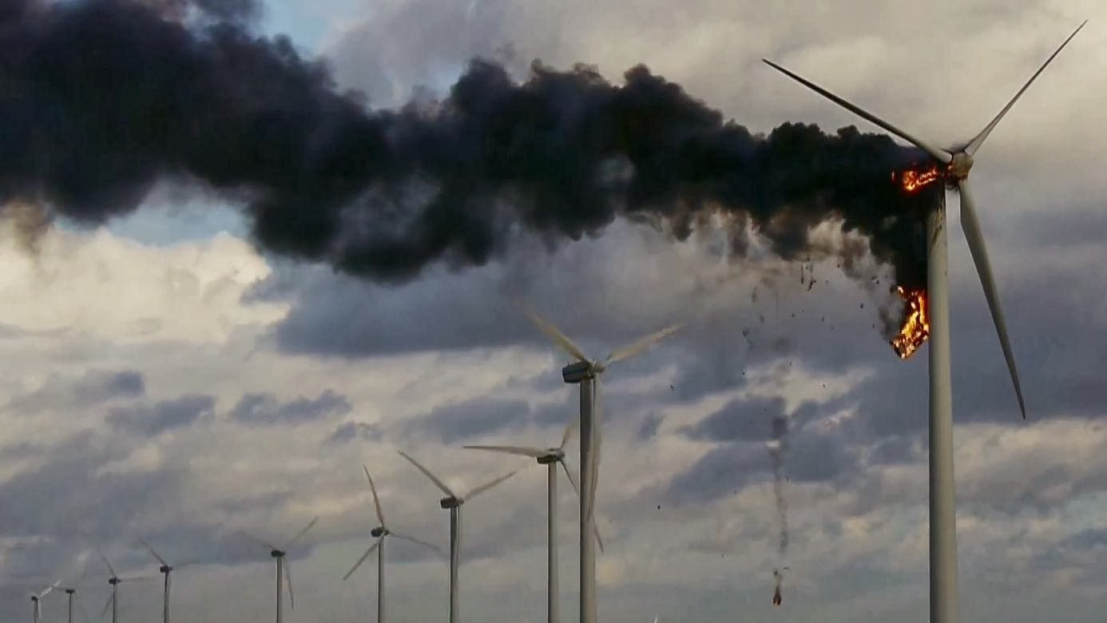
Problem Statement
Wind turbines exist in secluded areas with harsh conditions.
The increase of faults in wind turbines results in decrease of energy production, revenue and time.
OM costs of wind turbines are significantly high.
Lack of datasets containing data from Egyptian wind turbines.
Notes:
To avoid wind interference near cities, wind turbines are mostly located in secluded areas. Due to this allocation, the operation and maintenance costs tend to surge and the conditions of it (OM) become increasingly volatile due to unpredictable weather conditions. By predicting the faults in wind turbines before they occur and maintaining them accordingly and forecasting weather variables to predict wind power generation, the costs of maintenance will be reduced significantly and the wind farms will be able to operate sufficiently. In our research, one of the major problems agreed upon in this area of study is the lack of labeled datasets due to security problems related to data sharing. This made solutions depending on deep learning difficult since it depends on a great amount of data. On a local level, we were also faced with the problem of the lack of datasets containing data from Egyptian wind turbines which led to creating a simulation with the available data.
Wind power generation prediction to mazimize the utilization of wind farms.
Wind power generation prediction to mazimize the utilization of wind farms.

Slide 7


Similar Systems

Slide 8
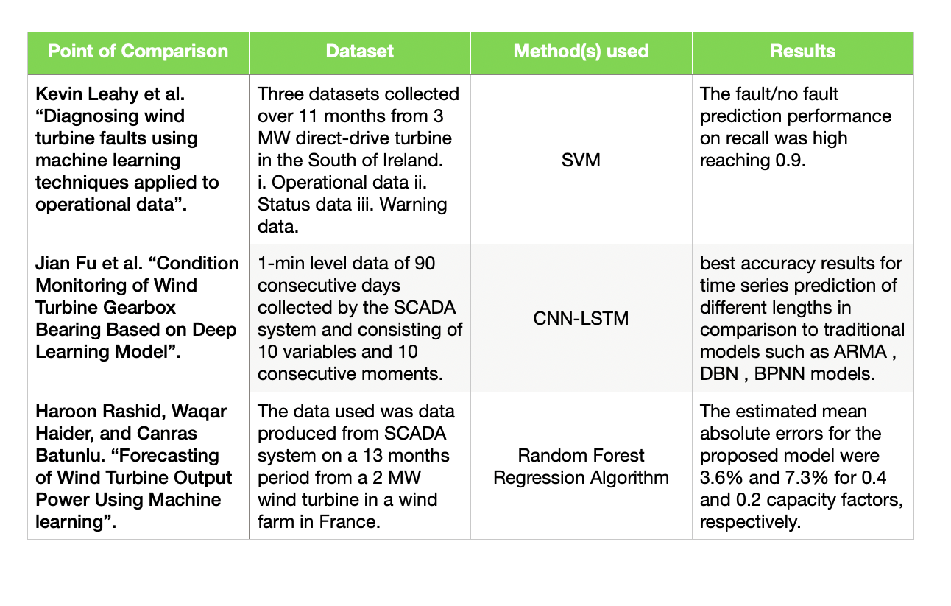

Slide 9
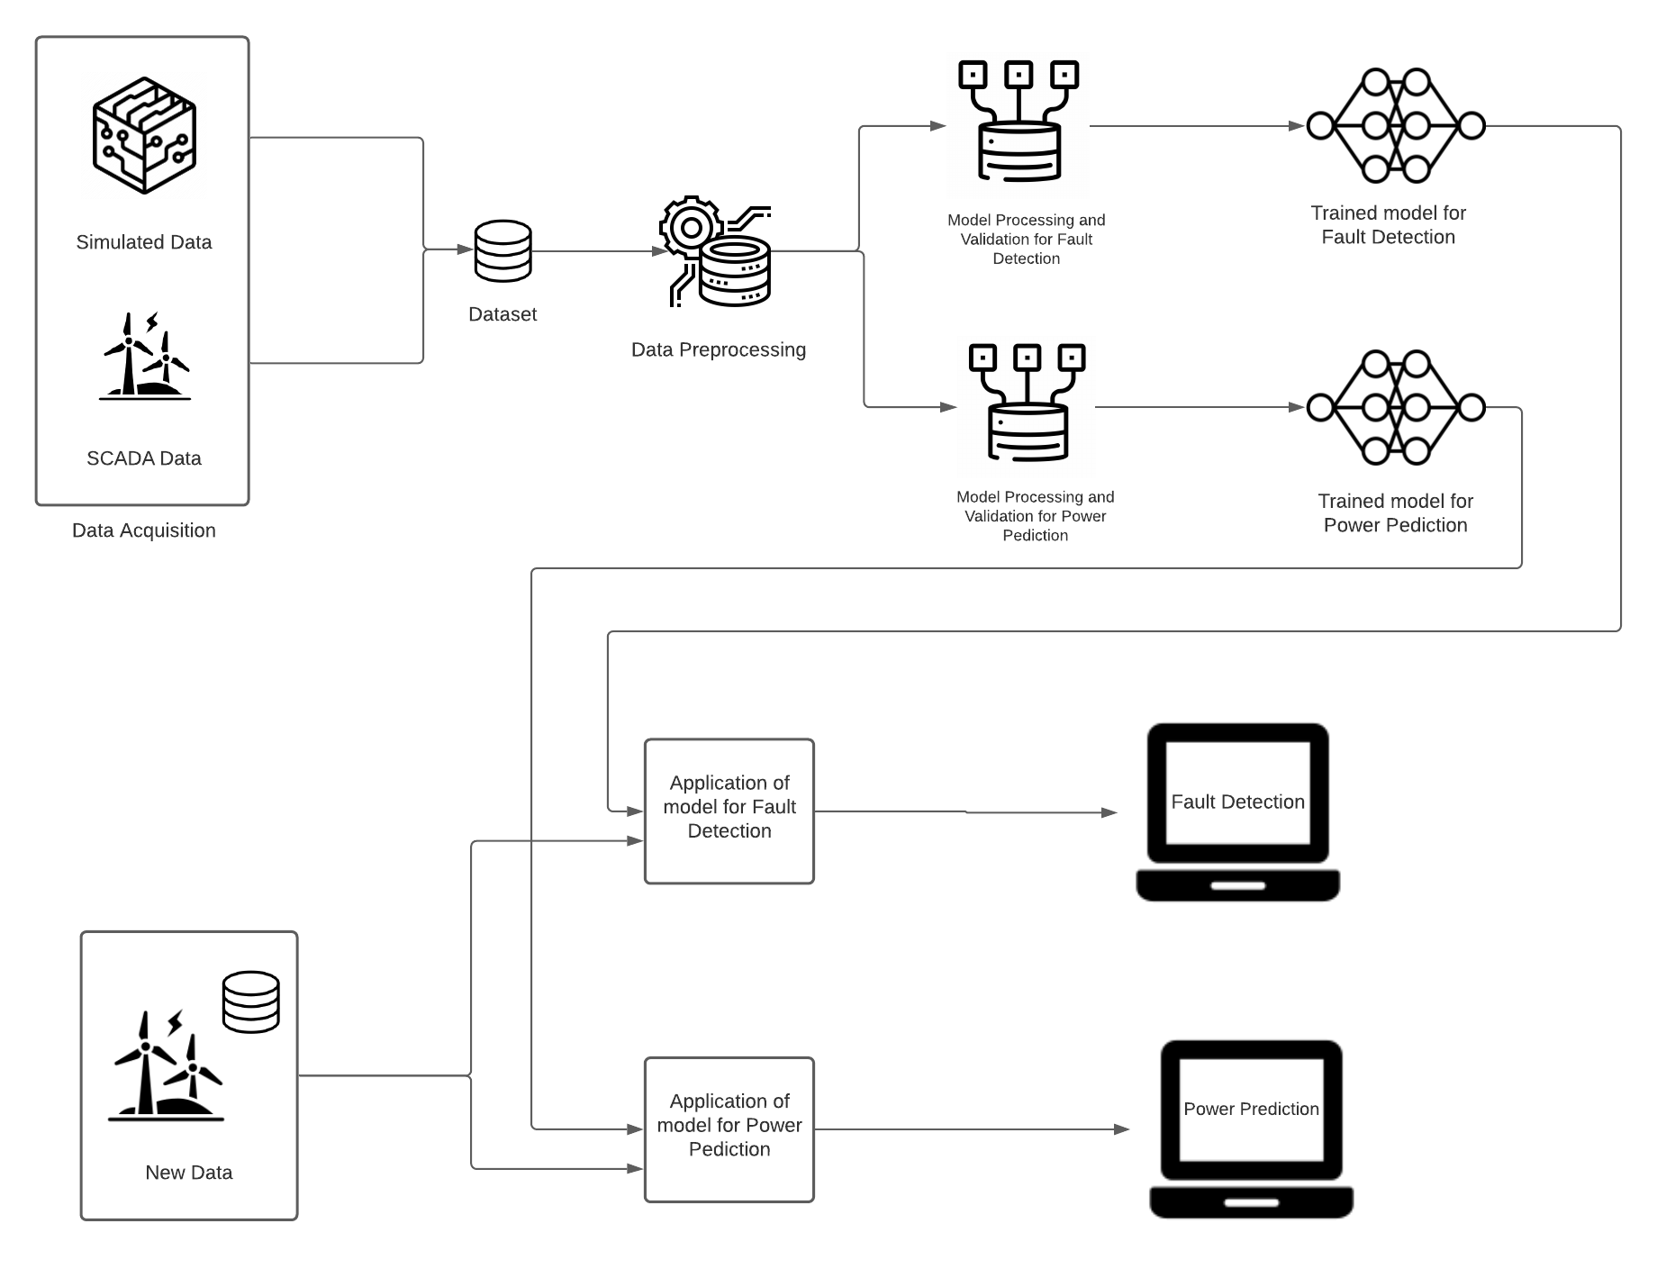
SYSTEM OVERVIEW

Slide 10
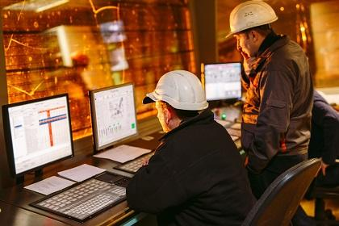
Deliverables
A web application that alerts field engineers of future deficiency that may occur in the wind and reports of the predicted wind power to be generated.
Software Requirement Specification document
Software Design document
Python backend

Slide 11
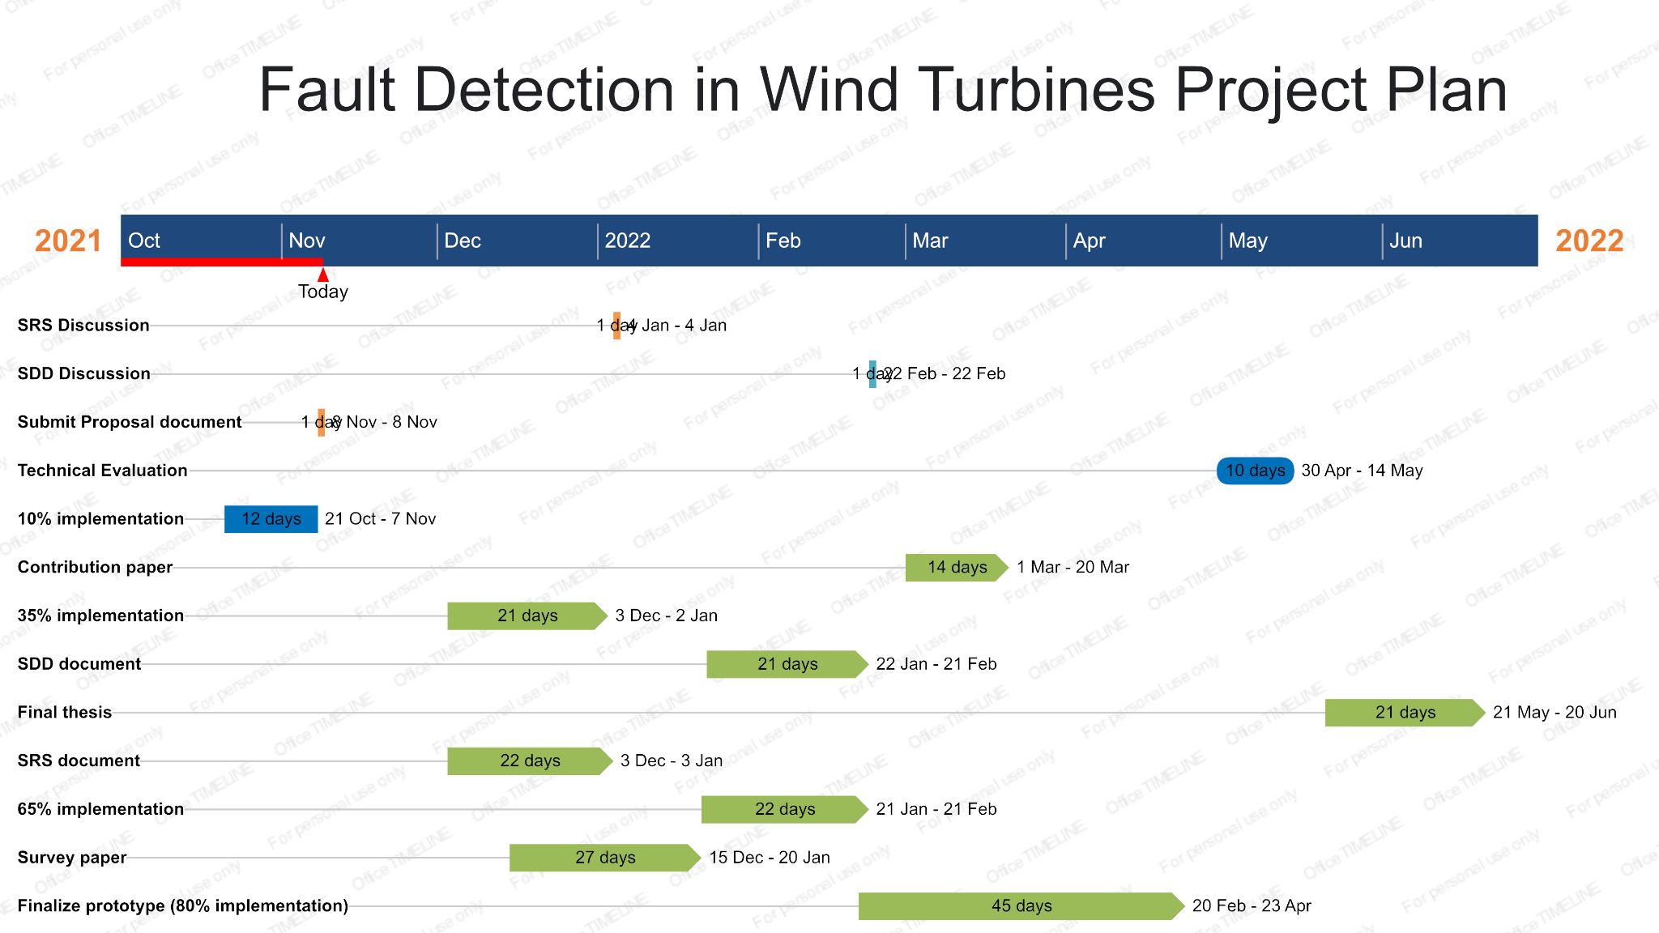
TIME PLAN

Slide 12
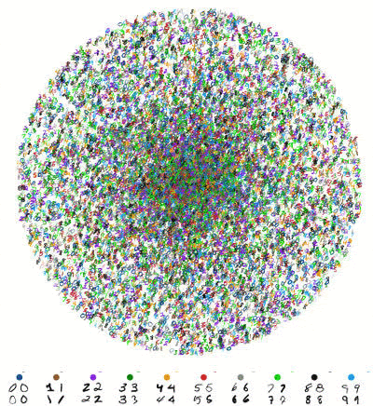

Supportive Documents
A dataset collected in Ireland collected in 2014/2015 that has time-stamped operational data for the turbine.
We’ve contacted different authors for datasets.

Slide 13

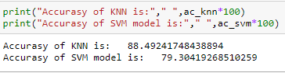
DEMO
KNN and SVM models

Slide 14
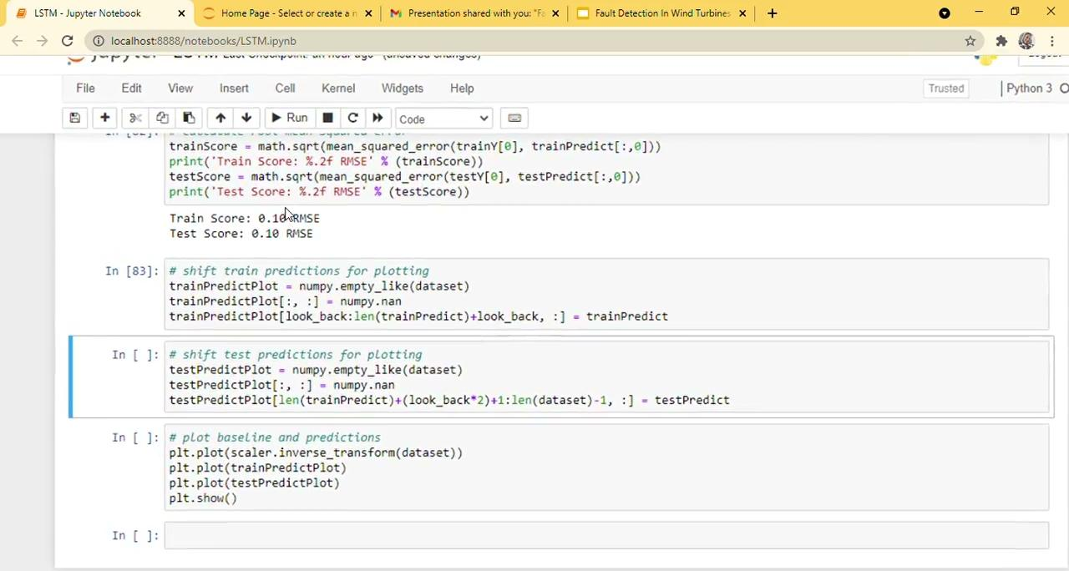
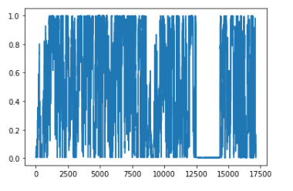
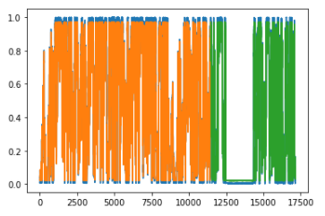
DEMO
LSTM model

Slide 15


Future Steps

Slide 16
References
Ana Rita Nunes, Hugo Morais, and Alberto Sardinha. “Use of Learning Mechanisms to Improve the Condition Monitoring of Wind Turbine Generators: A Review”. In: Energies 14.21 (2021). ISSN: 1996-1073. DOI: 10.3390/en14217129. URL: https://www.mdpi.com/1996-1073/14/21/7129.
ADMINISTRATOR THE RENEWABLE ENERGY HUB. Machine Learning Applications for Re- newable Energy Forecasting. URL: https://www.renewableenergyhub.co.uk/blog/machine- learning-applications-for-renewable-energy-forecasting/.
Mita Bhattacharya et al. “The effect of renewable energy consumption on economic growth: Evidence from top 38 countries”. In: Applied Energy 162.C (2016), pp. 733–741. DOI: 10.1016/j.apenergy. 2015.1. URL: https://ideas.repec.org/a/eee/appene/v162y2016icp733-741.html.
Kevin Leahy et al. “Diagnosing wind turbine faults using machine learning techniques applied to operational data”. In: 2016 IEEE International Conference on Prognostics and Health Management (ICPHM). 2016, pp. 1–8. DOI: 10.1109/ICPHM.2016.7542860.
Haroon Rashid, Waqar Haider, and Canras Batunlu. “Forecasting of Wind Turbine Output Power Us- ing Machine learning”. In: 2020 10th International Conference on Advanced Computer Information Technologies (ACIT). 2020, pp. 396–399. DOI: 10.1109/ACIT49673.2020.9208852.
Jian Fu et al. “Condition Monitoring of Wind Turbine Gearbox Bearing Based on Deep Learning Model”. In: IEEE Access 7 (2019), pp. 57078–57087. DOI: 10.1109/ACCESS.2019.2912621.

Slide 17
Thanks!
Do you have any questions?
]]
youremail@freepik.com +91 620 421 838 yourcompany.com

Slide 18
1970s
Mercury is the closest planet to the Sun and the smallest one in the Solar System—it’s only a bit larger than our Moon. The planet’s name has nothing to do with the liquid metal

Slide 19
01
02
INTRODUCTION
PRESENTATION
03
04
ANALYSIS
CONCLUSION
Describe the topic of the section
Describe the topic of the section
Describe the topic of the section
Describe the topic of the section

Slide 20
01
SECTION
You could enter a subtitle here if you need it

Slide 21
UNDERSTANDING THE PROBLEM
MARS
JUPITER
NEPTUNE
Despite being red, Mars is a cold place. It’s full of iron oxide dust
It’s a gas giant and also the biggest planet in our Solar System.
It’s the farthest planet from the Sun in our Solar System

Slide 22
333,000.00
EARTHS IS THE SUN’S MASS
Big numbers catch your audience’s attention

Slide 23
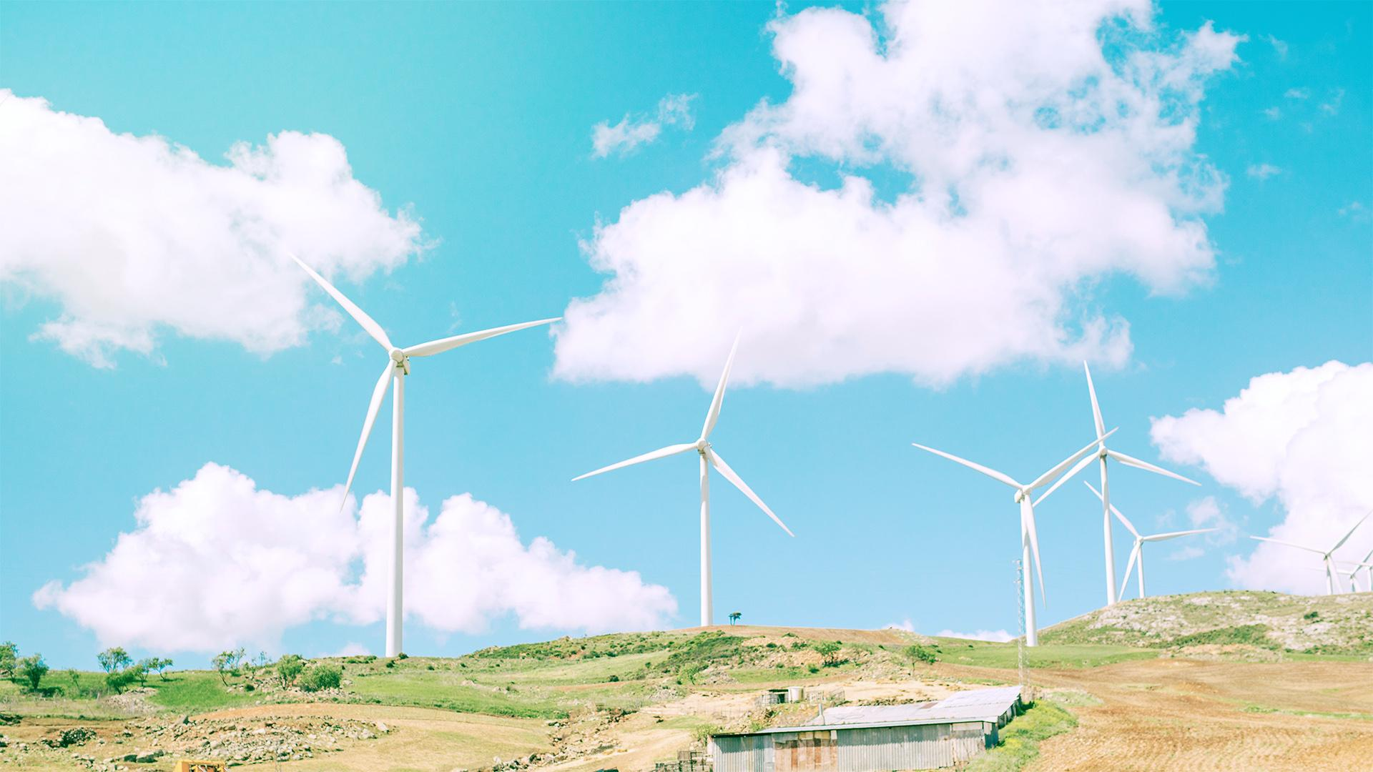
A PICTURE IS WORTH A THOUSAND WORDS

Slide 24
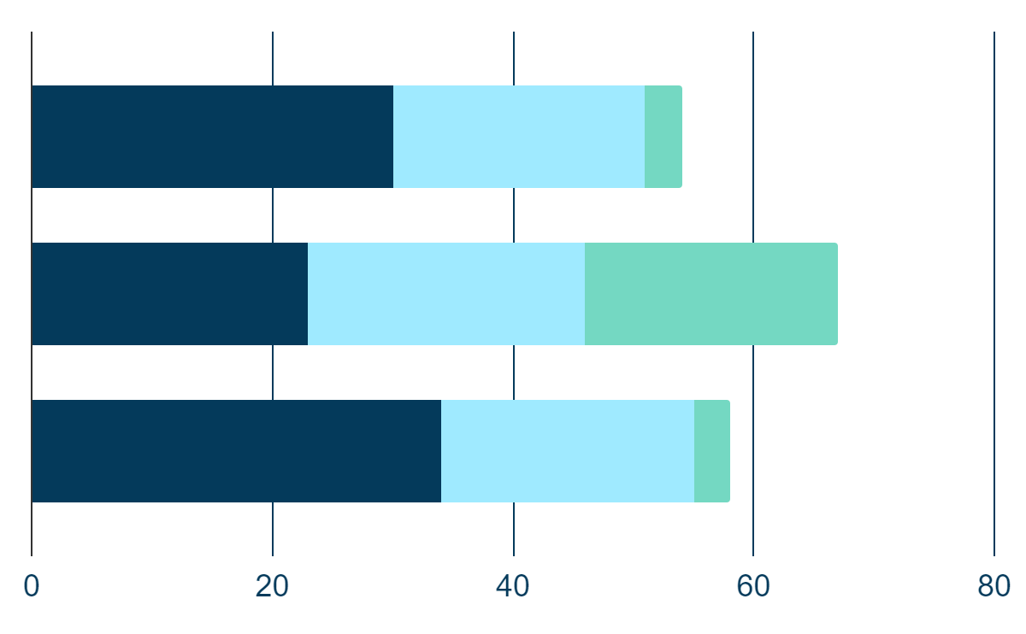
MAIN COMPETITORS
CUSTOMIZE IT!
VENUS
40%
If you want to modify this graph, click on it, follow the link, change the data and replace it
JUPITER
80%
MARS
50%

Slide 25
OUR PROCESS
MERCURY
MARS
NEPTUNE
SATURN
VENUS
Mercury is the closest planet to the Sun.
Mars is actually a cold place full of iron oxide
Neptune is the fourth-largest planet
Saturn is the ringed planet in Solar System
Venus is the second planet from the Sun

Slide 26
UPCOMING GOALS
VENUS
MARS
Venus has a beautiful name and is the second planet from the Sun
Despite being red, Mars is a cold place. It’s full of iron oxide dust

Slide 27
UPCOMING GOALS
MERCURY
JUPITER
NEPTUNE
Mercury is the closest planet to the Sun and the smallest one in the Solar System
Jupiter is a gas giant, the biggest planet in our Solar System and the fourth-brightest object in the sky
Neptune is the farthest planet from the Sun and the fourth-largest by diameter in our Solar System

Slide 28

A PICTURE ALWAYS REINFORCES THE CONCEPT

Slide 29
ANALYSIS
SATURN
MERCURY
VENUS
NEPTUNE
It’s a gas giant, composed mostly of hydrogen and helium
Mercury is the closest planet to the Sun and the smallest one
Venus is the second planet from the Sun. It’s very hot
Neptune is the farthest planet from the Sun

Slide 30
ANALYSIS
MARS
MERCURY
Despite being red, Mars is a cold place
Mercury is the closest planet to the Sun
VENUS
NEPTUNE
This planet is terribly hot in Solar System
Neptune is the farthest planet from the Sun

Slide 31
TARGET
VENUS
MARS
NEPTUNE
JUPITER
MARS
01
NEPTUNE
02
JUPITER
03

Slide 32
THIS IS
OUR
TEAM
JOHN DOE
JENNA DOE
JACK DOE
Talk a bit about this person
Talk a bit about this person
Talk a bit about this person

Slide 33
OUR PARTNERS
VENUS | MARS | JUPITER
Venus has a beautiful name and is the second planet from the Sun | Despite being red, Mars is actually a cold place. It’s full of iron oxide dust | Jupiter is a gas giant planet and the biggest planet in our Solar System
PARTNER | PARTNER | PARTNER

Slide 34
TESTIMONIALS
MARS
VENUS
MERCURY
JUPITER
SATURN
NEPTUNE
“Despite being red, Mars is actually a cold place. It’s full of iron oxide dust”
“Venus has a beautiful name and is the second planet from the Sun”
“This planet is named after the Roman messenger god”
“Jupiter is a gas giant and the biggest planet in our Solar System”
“Saturn is a gas giant, composed mostly of hydrogen and helium”
“Neptune is the fourth-largest planet in our Solar System”

Slide 35
AWARDS
AWARD
AWARD
AWARD
Mercury is the closest planet to the Sun and the smallest one
It has a beautiful name and is the second planet from the Sun
Jupiter is a gas giant and the biggest planet in our Solar System

Slide 36
ALTERNATIVE RESOURCES

Slide 37
ALTERNATIVE RESOURCES

